Slide 1
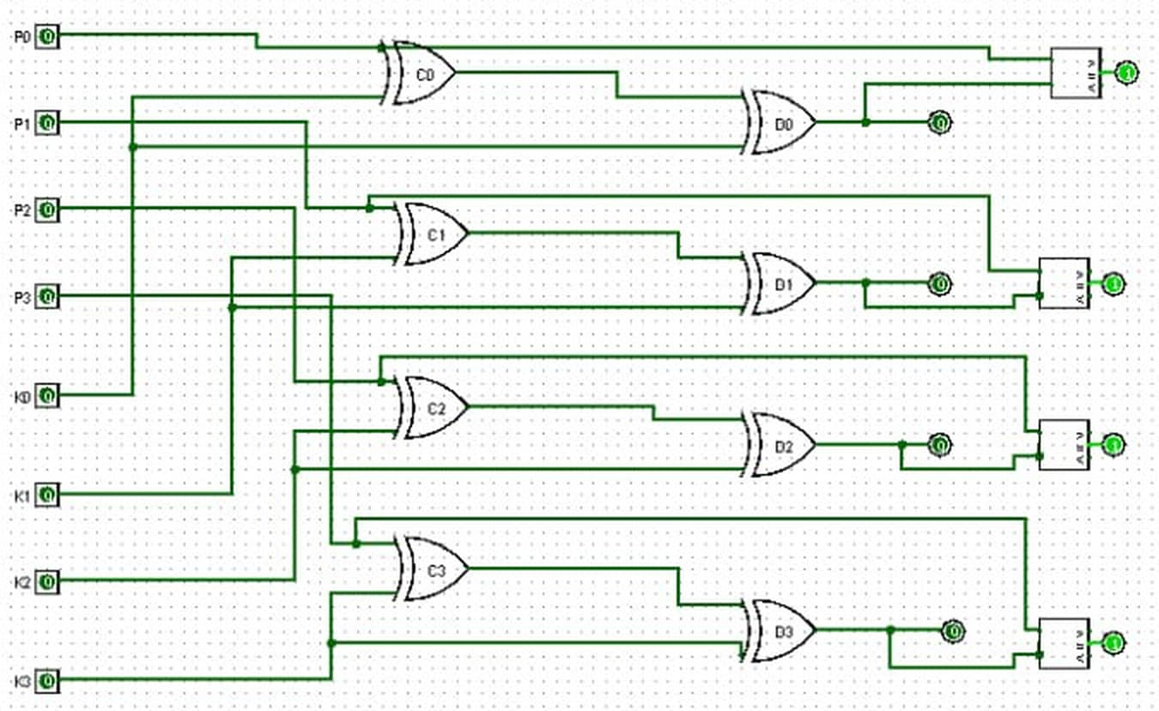
DDCA PROJECT · DEPARTMENT OF CSE
Design And Simulation Of Data Encryption & Decryption Unit
Design and simulation of a purely combinational, gate-level symmetric-key cipher in Logisim
PRESENTED BY
Shreyesh Reddy Gudi
Kaustubha Srinivas Kaseebhotla
Rachuri Harshita
Rudrakashala Harshitha
2620030608
2620030601
2620030654
2620030591
Guide: Kartheek B.Tech CSE · Batch-10 · AY 2026–2030 KL University, Hyderabad

Slide 2




Introduction
Background
CORE ELEMENT
Cryptography secures digital data. XOR is a fundamental building block of many ciphers because it is perfectly reversible.
XOR gate ( ⊕ )
CIRCUIT TYPE
Domain
Purely combinational
(no clock, no memory)
Digital Logic Design & Data Security — bitwise encryption and decryption implemented at the gate level and simulated in Logisim.
DATA WIDTH
4-bit plaintext + 4-bit key
Why it matters
Hardware-level encryption underpins secure embedded systems and the foundations of stream ciphers — turning Boolean algebra into a working circuit.
TOOL
Logisim simulation
DDCA Project | 4-Bit XOR Encryption & Decryption Unit
02 / 14

Slide 3




Problem Statement
The need: a simple, educational hardware implementation of symmetric encryption — the same key to encrypt and decrypt — built only from basic logic components, without complex algorithms or software libraries.
LIMITATIONS OF EXISTING APPROACHES
Software-only demos
Complex ciphers (AES, DES)
Incomplete student circuits
Hide gate-level hardware behaviour behind code and libraries.
Far too complex to design, wire and explain within an undergraduate lab.
Focus on physical security or encryption alone — no reversible decryption or verification logic.
DDCA Project | 4-Bit XOR Encryption & Decryption Unit
03 / 14

Slide 4

Literature Survey / Existing Systems
Approach | How it works | Limitation
Software XOR ciphers | XOR applied in program code | Easy to write, but offers no hardware insight
Block ciphers (AES, DES, Blowfish) | Complex multi-round algorithms | High gate count; not feasible to hand-wire in a lab
LFSR stream ciphers | Shift registers generate a pseudo-random key-stream | Needs flip-flops, memory and a clock
Access-control projects (RFID / keypad) | Compare an entered code with a stored value | Secure physical entry only — the data stays unprotected
Basic gate demos (AND / OR / NOT) | Illustrate individual gate behaviour | Rarely show reversible crypto; no verification stage
This project | 8 XOR gates + comparators, purely combinational | Reversible, self-verifying and lab-friendly
DDCA Project | 4-Bit XOR Encryption & Decryption Unit
04 / 14

Slide 5

Objectives
01
02
03
04
05
Encrypt
Decrypt
Verify
Simulate
Document
Build a 4-bit XOR encryptor:
Recover the plaintext with the same key:
Comparators confirm the output automatically:
Build and test the complete circuit in
Validate with truth tables for
C = P ⊕ K
D = C ⊕ K
D == P
Logisim
1-bit & 4-bit cases
Design constraint: gates and comparators only — no encoders, decoders or memory elements.
DDCA Project | 4-Bit XOR Encryption & Decryption Unit
05 / 14

Slide 6




Proposed System
THE CORE IDENTITY
(P ⊕ K) ⊕ K = P
Pure combinational
One shared key
8 single-bit XOR gates — no clock and no memory anywhere.
The same key lines drive both the encryption and decryption stages.
XOR is its own inverse, so one shared key both encrypts and decrypts — with perfect recovery of the original plaintext.
Built-in self-check
Modular & scalable
A complete 4-bit symmetric encryption–decryption system built from XOR gates and comparators.
Comparators confirm Decrypted == Plaintext for every test vector.
Bit-level stages C0–C3 and D0–D3; extendable to 8/16-bit designs.
DDCA Project | 4-Bit XOR Encryption & Decryption Unit
06 / 14

Slide 7

System Architecture
PLAINTEXT
XOR ENCRYPT
CIPHERTEXT
XOR DECRYPT
DECRYPTED
P3 – P0
C = P ⊕ K
C3 – C0
D = C ⊕ K
D3 – D0
same key reused
KEY K3 – K0
COMPARATOR
MATCH = 1 if D = P
original plaintext (reference for verification)
Key insight: XOR is its own inverse → (P ⊕ K) ⊕ K = P
DDCA Project | 4-Bit XOR Encryption & Decryption Unit
07 / 14

Slide 8


Methodology / Implementation
1
2
3
4
5
Define inputs
Encrypt
Decrypt
Verify
Simulate
Pins P0–P3 (plaintext) and K0–K3 (key)
Four XOR gates: C0 = P0⊕K0 … C3 = P3⊕K3
Four more XOR gates reuse the same key lines
Comparators check each decrypted bit against its plaintext bit
Poke P and K live; D always equals P
CORE LOGIC EQUATIONS
C_{i} = P_{i} ⊕ K_{i}
D_{i} = C_{i} ⊕ K_{i} = P_{i}
Match_{i} = (D_{i} == P_{i})
Tools: Logisim — Wiring, Gates and Arithmetic libraries
DDCA Project | 4-Bit XOR Encryption & Decryption Unit
08 / 14

Slide 9
Logisim Implementation — Complete Circuit
INPUTS
ENCRYPT C0–C3
DECRYPT D0–D3
VERIFY
8
input pins
4 plaintext + 4 key
8
XOR gates
4 encrypt + 4 decrypt
4
comparators
one per bit: D vs P
0
flip-flops
no clock, no memory
DDCA Project | 4-Bit XOR Encryption & Decryption Unit
09 / 14

Slide 10

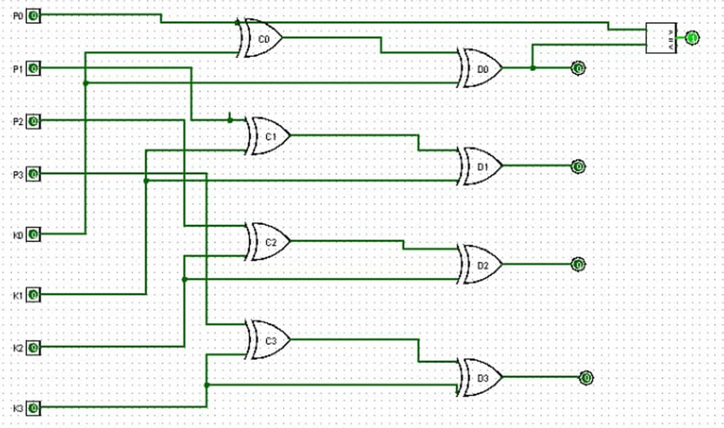
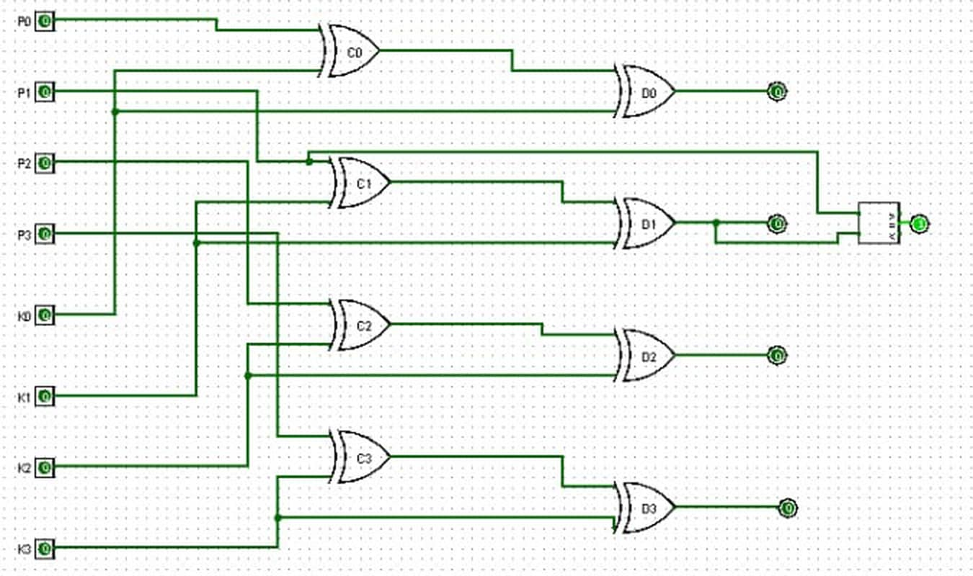

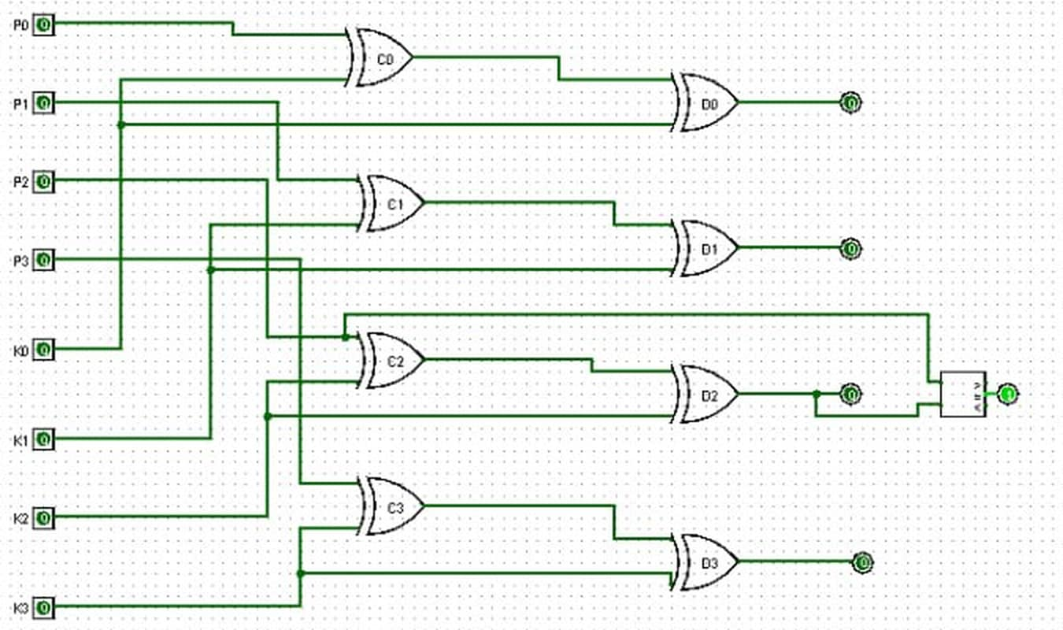
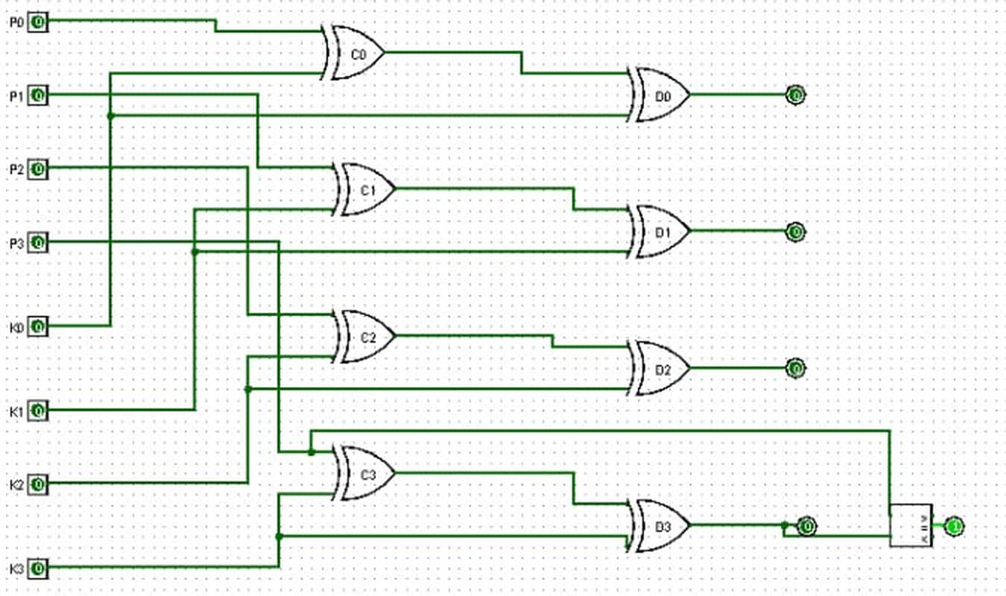
Bit-by-Bit Verification in Simulation
STAGE 1 Comparator on Bit 0
STAGE 2 Comparator on Bit 1
How it was verified
One bit at a time
A comparator is wired to the plaintext and decrypted line of each bit in turn.
Lit output = match
STAGE 3 Comparator on Bit 2
STAGE 4 Comparator on Bit 3
The comparator output confirms that bit survives the round trip.
Combined result
All four comparators run together in the final build (previous slide).
DDCA Project | 4-Bit XOR Encryption & Decryption Unit
10 / 14

Slide 11

Results — Truth Table & Test Vector
1-bit encrypt / decrypt round trip
Example 4-bit test vector
P | K | C = P⊕K | D = C⊕K | Match
0 | 0 | 0 | 0 | ✓ Yes
0 | 1 | 1 | 0 | ✓ Yes
1 | 0 | 1 | 1 | ✓ Yes
1 | 1 | 0 | 1 | ✓ Yes
Plaintext P
1
0
1
1
Key K
⊕
1
1
0
0
Ciphertext C
0
1
1
1
Key K
⊕
1
1
0
0
For every row, D reproduces P exactly.
Decrypted D
1
0
1
1
✓ D = P → MATCH
DDCA Project | 4-Bit XOR Encryption & Decryption Unit
11 / 14

Slide 12



Results & Discussion
16 / 16
8
4
0
input combinations of P and K recovered perfectly
XOR gates form the complete cipher
bit-wise comparators give instant feedback
flip-flops, clocks or memory elements
Finding
Limitation
Across every tested combination, the decrypted output D exactly reproduced the plaintext P and the MATCH output stayed high — confirming correctness at the gate level.
An educational single-round cipher, not production-grade: reusing one key across messages would be vulnerable.
DDCA Project | 4-Bit XOR Encryption & Decryption Unit
12 / 14

Slide 13




Conclusion & Future Scope
WHAT WAS ACHIEVED
FUTURE SCOPE
Designed and simulated a complete 4-bit symmetric XOR cipher in Logisim
Wider data path
Scale to 8- or 16-bit words
Verified (P ⊕ K) ⊕ K = P across all tested vectors — perfect recovery
Integrated comparators for real-time correctness feedback
Pseudo-random keys
Add a key generator or key schedule
Documented behaviour with truth tables and worked test cases
Building block
Kept the design minimal: no encoders, decoders or memory
Reuse as a module in larger designs
All stated objectives were fulfilled — the circuit is ready for demonstration and further academic exploration.

Slide 14

Thank You
Shreyesh Reddy Gudi · Kaustubha Srinivas Kaseebhotla · Rachuri Harshita · Rudrakashala Harshitha
Guide: Lakshmi Karthek Vankamamidi · Computer Science and Engineering, KL University, Hyderabad

